Slide 1
UNIT 2: NETWORK OPERATING SYSTEM (NOS)
An operating system is a program that manages the computer hardware, provides a basis for application programs and acts as an intermediary between the user and the hardware.
Common examples of operating systems include Windows, Unix, Linux and Mac
Network operating system is the software that enhances a basic operating system by adding networking features.

Slide 2
FEATURES OF NETWORK OPERATING SYSTEMS
Centrally manage network resources, such as programs, data, and devices (for example, printers).
Secure accessibility to a network.
Allow remote users to connect to a network and other networks
  (for example, the Internet).
Back up data and make sure it’s always available.
Allow for simple additions of clients and resources.
Monitor the status and functionality of network elements.
Distribute programs and software updates to clients.
Ensure efficient use of a server’s capabilities.
Provide fault tolerance in case of a hardware or software problem

Slide 3
NOS ARCHITECTURES
Peer-to-peer NOS
In this network users are allowed to share resources and files located on their computers and access shared resources from others. This system is not based with having a file server or centralized management source.
A peer-to-peer network sets all connected computers equal. They all share the same abilities to use resources available on the network

Slide 4
NOS ARCHITECTURES
Peer-to-peer
Advantages
  Ease of setup
  Less hardware needed, no server needs to be purchased thus it is cheap to setup.
Disadvantages
  No central location for storage.
  Lack of security that a client-server type offers
  It is difficult to share resources

Slide 5
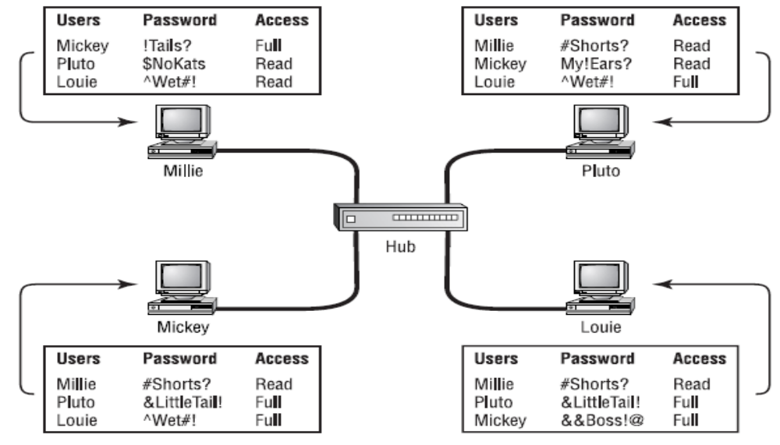
NOS ARCHITECTURES
Peer to peer diagram

Slide 6
NOS ARCHITECTURES
Client-Server NOS
The server enables multiple clients to share resources. Client-server network operating systems allow the network to centralize functions and applications in one or more dedicated file servers.
The server is the center of the system, allowing access to resources and instituting security. It is designed to process requests and deliver data to other (client) computers over a local network or the Internet.
The client is the computer hardware or software that accesses a service made available by a server. The server is often (but not always) on another computer system, in which case the client accesses the service by way of a network.

Slide 7
NOS ARCHITECTURES
Client-Server NOS
Many types of servers exist, including web servers, mail servers, and file servers. Each type runs software specific to the purpose of the server.
Advantages
  Centralized servers are more stable.
  Security is provided through the server.
  New technology and hardware can be easily integrated into the system.
  Servers are able to be accessed remotely from different locations and types of systems.
Disadvantages
  Cost of buying and running the OS is high.
  Dependence on a central location for operation.
  Requires regular maintenance and updates.

Slide 8
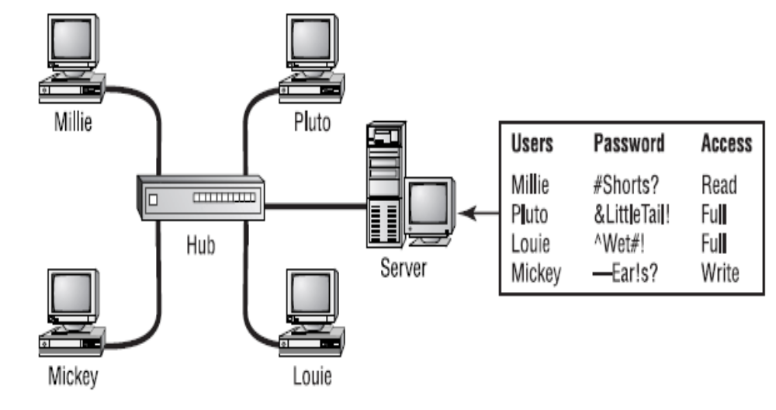
NOS ARCHITECTURES
Client-Server diagram

Slide 9
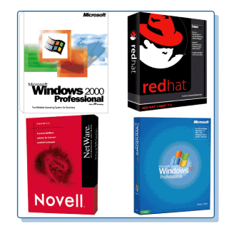
TYPES OF NOS

Slide 10
TYPES OF NOS
Windows Server
Windows Server is a group of operating systems designed by Microsoft that supports enterprise level management, data storage, applications and communications.
Windows servers are more powerful versions of their desktop operating system counterparts and are designed to more efficiently handle corporate networking, Internet/intranet hosting, databases, enterprise-scale messaging and similar functions.
Previous versions of Windows Server have focused on stability, security, networking, and various improvements to the file system. Other improvements have included better deployment technologies and increased hardware support.

Slide 11
TYPES OF NOS
UNIX and Linux
UNIX and Linux differ in fundamental ways from Windows Server NOSs. UNIX preceded and led to the development of the TCP/IP protocol suite in the early 1970s.
Linux is a popular example of a freely available and nonproprietary operating system that resembles UNIX. Today, most Internet servers and many servers on private WAN and LANs rely on UNIX or Linux.
The differences between UNIX and Linux varieties are relatively minor. If you understand how to use one, with a little effort you can understand how to use another.

Slide 12
TYPES OF NOS
UNIX and Linux
Linux is an operating system similar to UNIX. It runs on many different computers and was first released in 1991.
Linux is portable, which means versions can be found running on name brand or clone PCs.
Linux offers many features adopted from other versions of UNIX.
Linux brings the advantages of UNIX to home and small business computers.
The following are a few of the most popular types:
  Red Hat Linux
  Linux Mandrake
  Caldera eDesktop and eServer
  Debian GNU/Linux
  Corel Linux

Slide 13
TYPES OF NOS
Common Characteristics of UNIX and Linux
Today, the UNIX operating system comes in many varieties, or distributions. Before learning about their differences, however, you should know that all varieties of the UNIX and Linux operating system share the following features:
  The ability to support multiple, simultaneously logged-on users
  The ability to coordinate multiple, simultaneously running tasks (or programs)
  The ability to mount or to make available disk partitions upon demand
  The ability to apply permissions for file and directory access and modification

Slide 14
TYPES OF NOS
Common Characteristics of UNIX and Linux
  A uniform method of issuing data to or receiving data from hardware devices, files, and running programs
  The ability to start a program without interfering with a currently running program
  Supports hundreds of subsystems, including dozens of programming languages
  Source code portability, or the ability to extract code from one UNIX system and use it on another.

Slide 15
Types of the UNIX operating system
Proprietary UNIX
An implementation of UNIX for which the source code is either unavailable or available only by purchasing a licensed copy is known as proprietary UNIX. The three most popular vendors of proprietary UNIX are Apple Computer, Sun Microsystems, and IBM.

Slide 16
Types of the UNIX operating system
Advantages of proprietary UNIX
Accountability and support— An organization might choose a proprietary UNIX system so that when something doesn’t work as expected, it has a resource on which to call for assistance.
Optimization of hardware and software—Workstation vendors who include proprietary UNIX with the computers they sell invest a great deal of time in ensuring that their software runs as well and as fast as possible on their hardware.
Predictability and compatibility—Vendors of proprietary UNIX systems strive to maintain backward compatibility with new releases. They schedule new releases at regular, predictable intervals. Customers usually know when and how things will change with proprietary UNIX systems.

Slide 17
Types of the UNIX operating system
Open source UNIX
Enables network users to have access to the system’s source code and thus customize the operating system
Class discussion
Discuss the advantages of installing open source Unix

Slide 18
Domain Vs Workgroup
Domain
It is a group of computers and devices on a network that are administered as a unit with common rules and procedures.
Within the Internet, domains are defined by the IP address. All devices sharing a common part of the IP address are said to be in the same domain.
Workgroup
In computer networking, a workgroup is a collection of computers on a local area network (LAN) that share common resources and responsibilities. Workgroups provide easy sharing of files, printers and other network resources.
The Microsoft Windows family of operating systems supports assigning of computers to named workgroups.

